Slide 1

Predicting multiple molecular properties for identification of new protein using Datamining techniques
Guided by –
Dr. Shouyi Wang
Presented by -
Shekhar Khairnar

Slide 2
Introduction
What are proteins?
Protein play a significant role in chemical process in our daily life. Protein consists of thousands of amino acids. There are many different forms of proteins.
Molecular Properties of protein COUMPOUNDS to be evaluated from the encoded fingerprints.
SMILES - standard representation of compounds for modern chemical information processing.
Fingerprints of chemical - A “fingerprint” is a vector that represents a property of a chemical compound
For the project proteins are decoded in form of smiles

Slide 3
Introduction
THE AMINO ACID COMPOSITION AND MOLECULAR PROPERTIES LIKE MOLECULAR WEIGHT, LIPOPHILICITY, TOPOLOGICAL POLAR SURFACE AREA PRODUCED BY A CERTAIN TYPE OF BACTERIA WHICH IS DIFFERENT FROM THOSE PROTEIN FORMING COAT OF VIRUS.
THE ABILITY TO CORRECTLY IDENTIFY PROTEIN ALLOW RESEARCHERS TO DETERMINE WHETHER AN ORGANISM HAS A GENETIC DISEASE.

Slide 4
Data Extraction And Preprocessing
Data Extracted from pubchem website in 2 types of files SDF and JDX file format.
Converting files to readable format for ML model using rdkit
ENCODING FINGERPRINTS FROM SMILES IN SDF FILES
DECIDING ON THE OUTPUT VARIABLES (MOLECULAR PROPERTIES)

Slide 5
Machine learning models used
Linear regression
(MULTI-OUTPUT REGRESSION)
Random forest MULTIOUTPUT REGRESSION
KNN REGRESSION
GRADIENT BOOSTING

Slide 6
Metrics used
ADJUSTED R-SQUARED
01
RMSE
02
R2 SCORE
03
MEAN ABSOLUTE ERROR
04

Slide 7
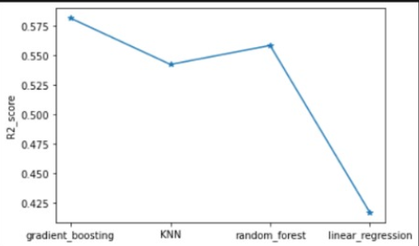
R2 score

Slide 8
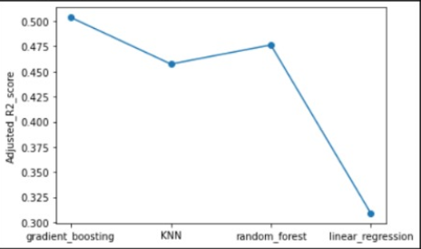
Adjusted R2 score

Slide 9
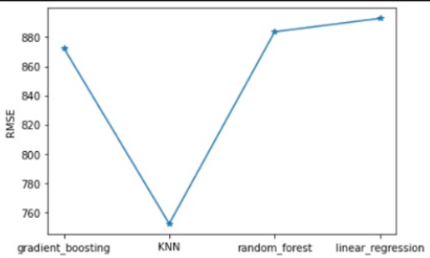
Rmse

Slide 10
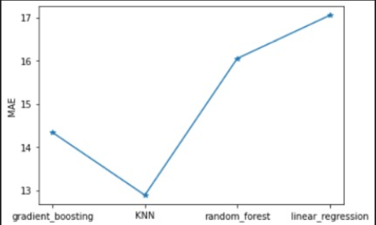
Mean absolute error (mae)

Slide 11

Visualizing model results

Slide 12
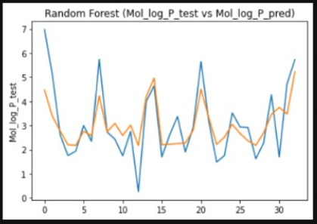
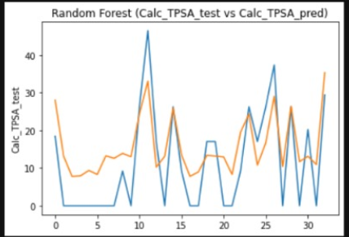
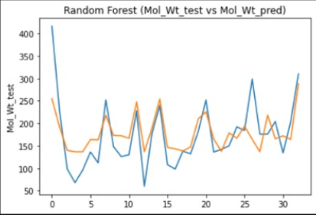
RANDOM FOREST

Slide 13
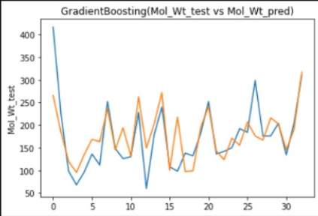
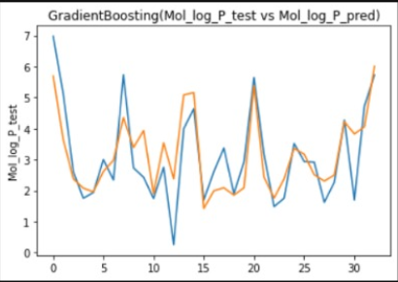
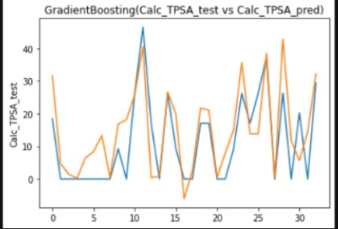
Gradient boosting

Slide 14
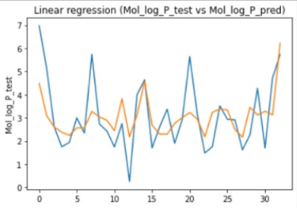
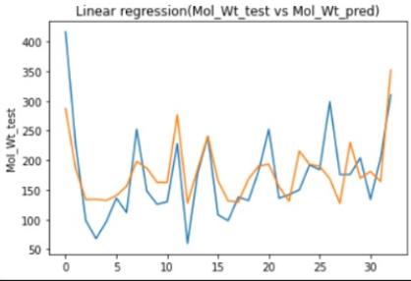
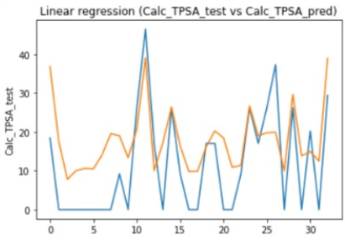
Linear regression

Slide 15
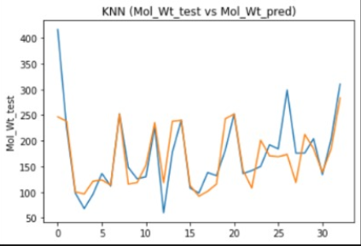
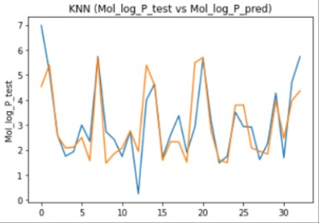
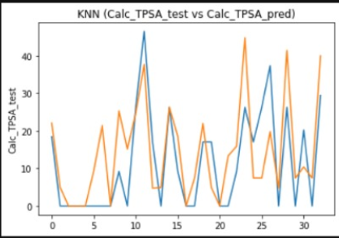
Knn regressor

Slide 16
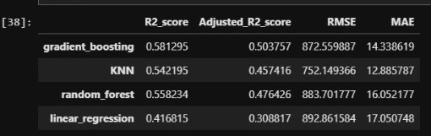
RESULTS
GRADIENT BOOSTER TURNS OUT TO BE THE BEST WHEN COMPARED WITH OTHER ML ALGORITHMS

Slide 17
FUTURE WORK
NEED TO MERGE OTHER AVALIABLE DATASET AND CHECK WITH METRICS AS THE ACCURACY WILL INCREASE IF MORE DATA IS AVAILABLE FOR TRAINING TESTING.
NEED TO HAVE COMPUTER WITH POWERFUL PROCESSOR FOR LARGE DATASET EXPLORATION AS THIS PROJECT IS COMPUTATIONALLY EXPENSIVE
ALSO WORKING ON PREDICTION OF MASS SPECTRUM OF THE CHEMICAL COMPOUNDS.

Slide 18
aCKNOWLEDGEMENT
I WOULD LIKE TO THANK DR. SHOUYI WANG AND TEACHING ASSISTANT LINH HO FOR THEIR CONSTANT SUPPORT AND GUIDANCE.

Slide 19
Thank you

